Slide 1
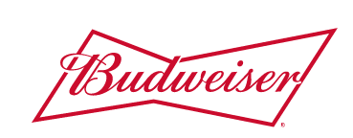

Budweiser Data Analysis
Paul Huggins & Vijayasrikanth Kaniti

Slide 2
Project scope
The goal of this project was to detect and analyze the relationships between a data points supplied by Budweiser containing details regarding different beers and breweries.
The following 6 questions were of interest:
1. How many breweries are present in each state?
2. Address the missing values in each column.
3. Compute the median alcohol content and international bitterness unit for each state. Plot a bar chart to compare.
4. Which state has the maximum alcoholic (ABV) beer? Which state has the most bitter (IBU) beer?
5. Comment on the summary statistics and distribution of the ABV variable.
6. Is there an apparent relationship between the bitterness of the beer and its alcoholic content? Draw a scatter plot.

Slide 3
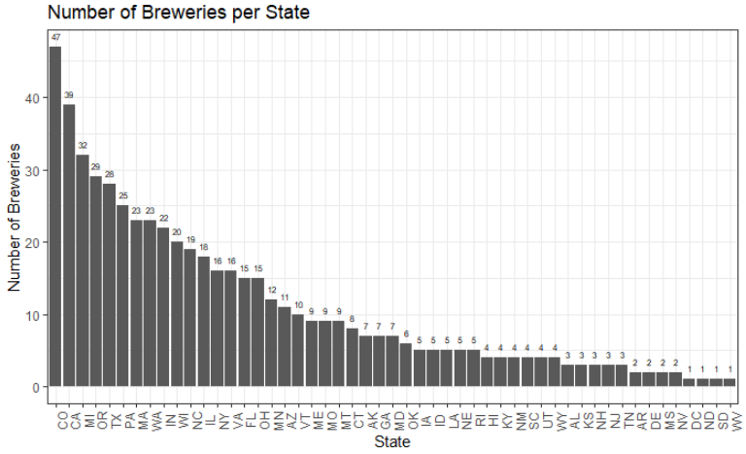
How many breweries are present in each state?
Top 5 States | Number of Breweries
Colorado | 47
California | 39
Michigan | 32
Oregon | 29
Texas | 28

Slide 4
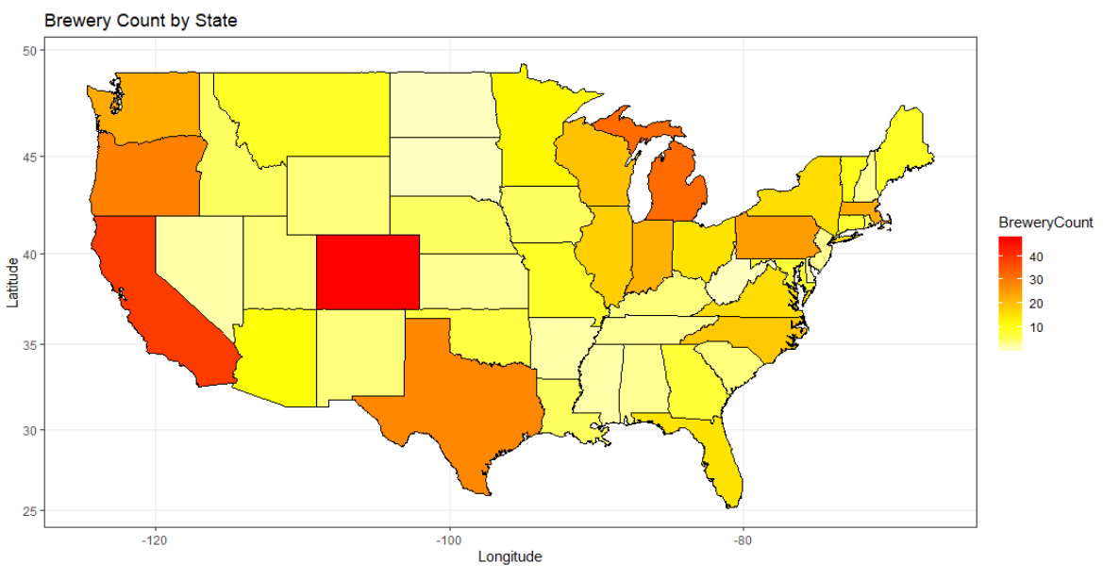
How many breweries are present in each state?

Slide 5
Address the missing values in each column.
There were 62 missing values in the ABV column and 1005 missing values in the IBU column.
To address this, we looked at three options:
Removing the rows with missing data.
Setting all the missing values to be the median value of the entire column.
Using a linear regression model to impute what the data values might be by keying off of rows with complete data and assessing the relationship between the values. Imputation was done using the Mice package in R Studio and the method we used was predictive mean matching.
After implementing the Mice package, we obtained better estimated values for ABV and IBU which defined a more clear relationship between the two variables.

Slide 6
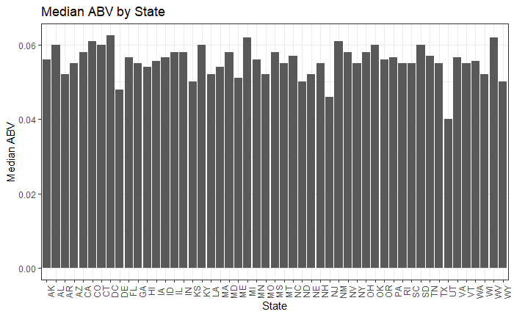
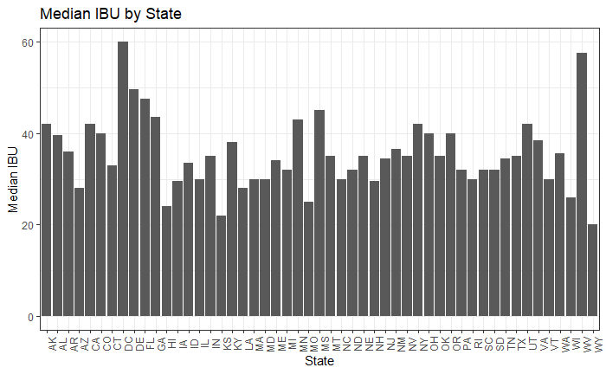
Compute the median alcohol content and international bitterness unit for each state. Plot a bar chart to compare.
The median ABV by state was relatively constant with the overall median being 0.056 or 5.6%.
The median IBU by state contained more variance with the overall median being 35 Units.

Slide 7
Which state has the maximum alcoholic (ABV) beer? Which state has the most bitter (IBU) beer?
State | Maximum ABV | Brewery | Beer
Colorado | 0.128 | Upslope Brewing Company | Lee Hill Series Vol. 5 – Belgian Style Quadrupel Ale
Kentucky | 0.125 | Against the Grain Brewery | London Balling
Indiana | 0.120 | Tin Man Brewing Company | Csar
State | Maximum IBU | Brewery | Beer
Oregon | 138 | Astoria Brewing Company | Bitter Bitch Imperial Ale
Virginia | 135 | Wolf Hills Brewing Company | Troopers Alley IPA
Maine | 130 | Cape Ann Brewing Company | Dead-Eye DIPA

Slide 8
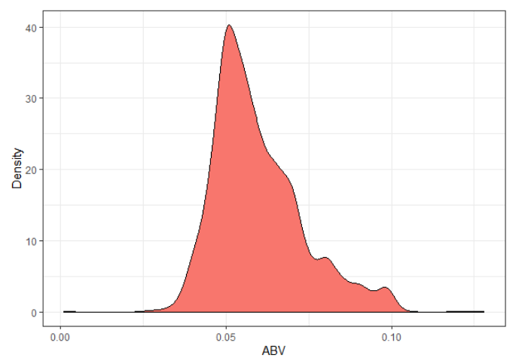
Comment on the summary statistics and distribution of the ABV variable.
The average ABV of all the Beers in the dataset was 0.059 (5.9%).
It is safe to assume that the majority of beers have an ABV greater than 0.059 which could tell us something about the palette of the American Consumer.
Summary Statistics:
Max: 0.128
3rd Quarter: 0.067
Mean : 0.059
Median: 0.056
1st Quarter: 0.050
Minimum: 0.001

Slide 9
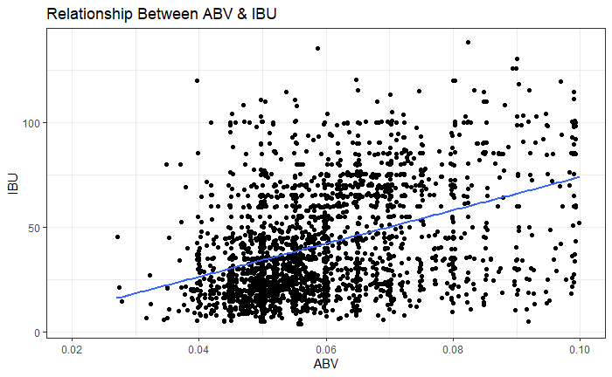
Is there an apparent relationship between the bitterness of the beer and its alcoholic content? Draw a scatter plot.
There appears to be a positive relation between IBU & ABV.
There are a couple of factors that could contribute to this:
Americans may prefer a more balanced beer instead of a beer that favors ABV over IBU or vice versa.
To offset the taste of the bitterness, more hops are added which would result in a positive relationship.

Slide 10
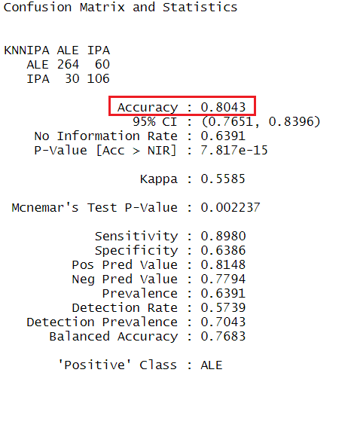
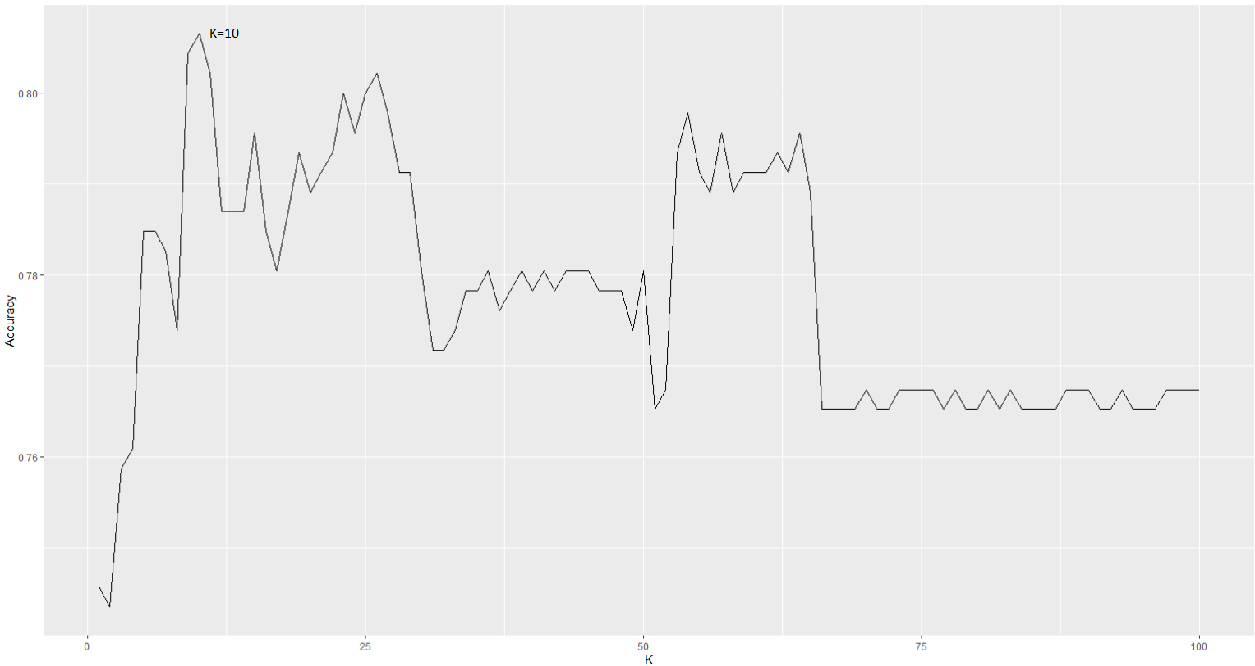
knn CLASSIFICATION
Using KNN Classification technique we were able to classify Style of Beer based on ABV and IBU with
an accuracy of 80.43%

Slide 11
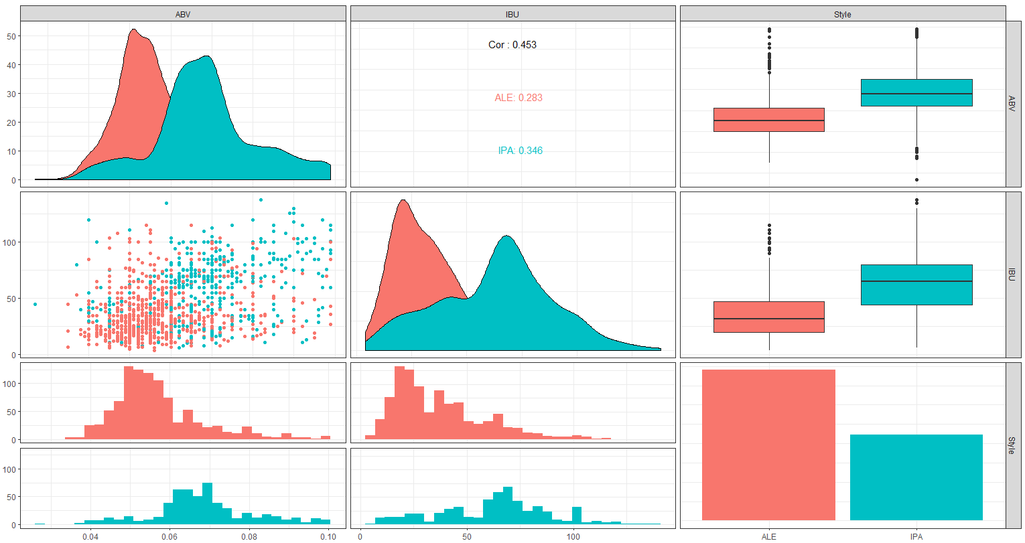
KNN results
We can say from below graph there is enough evidence that IPA's generally have higher IBU & ABV values
compared to Ales kind of Beers

Slide 12
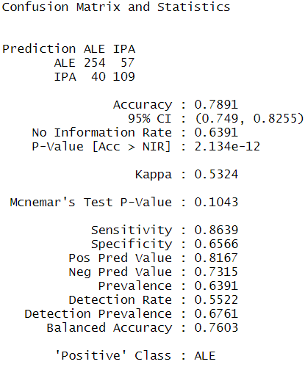
Naive-bayes classification
Using NB classification technique we can say Beers can be classified based on IBU and ABY with an accuracy of 78.91% slightly less than KNN method

Slide 13
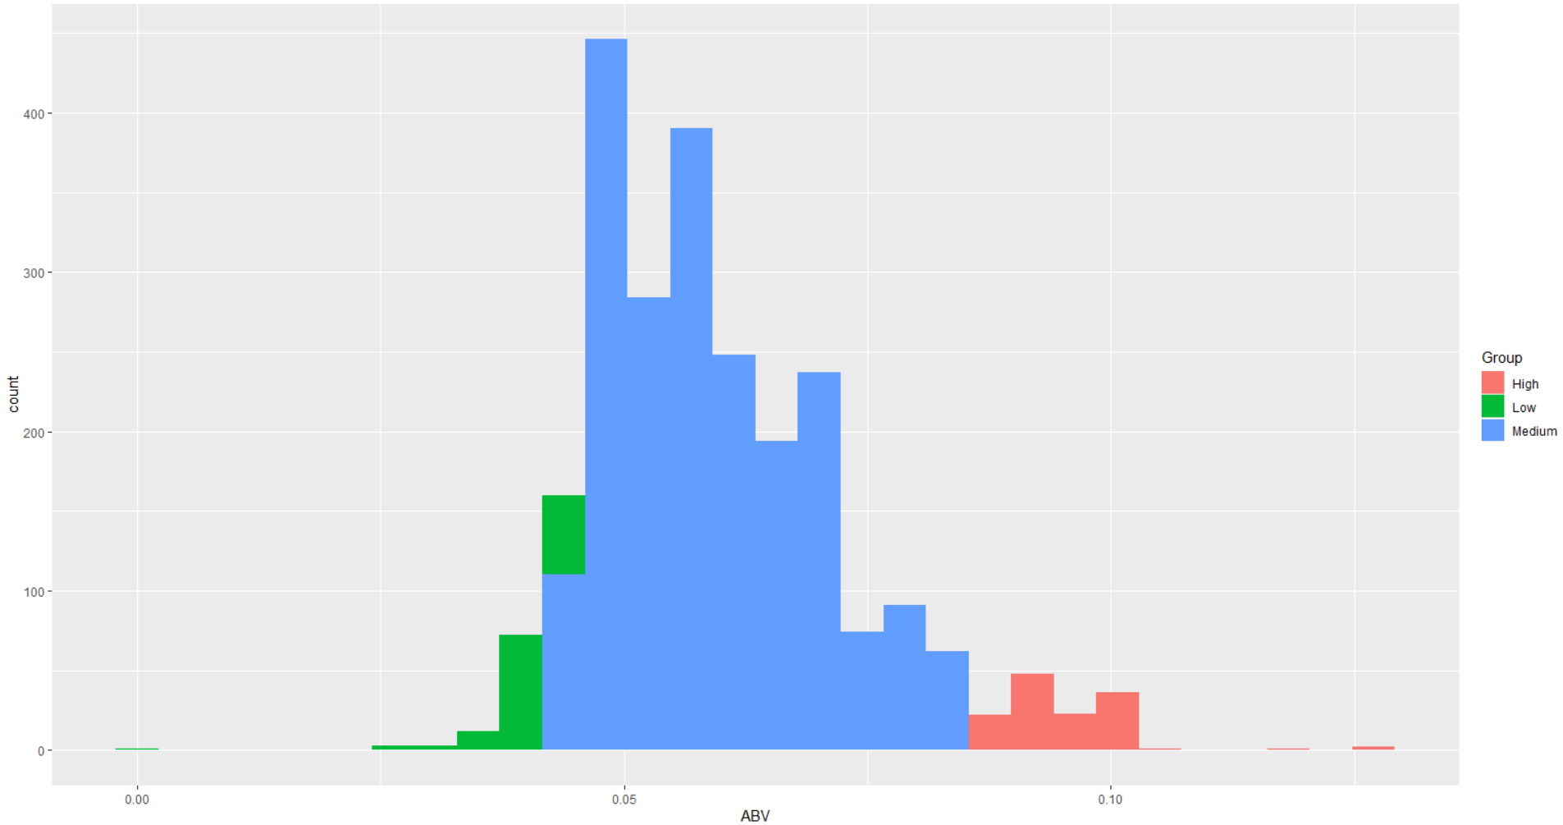
Most likeable beers ?
Divided ABV of different beers into Low, Medium , High groups.
From the plot its clearly visible that most people like Beers which have medium alcohol content.

Slide 14
Thank you

Slide 16
Appendix – question 2
Paul Huggins & Vijayasrikanth Kaniti

Slide 17
Merge the beer data with the breweries data. Print the first 6 observations and the last six observations to check the merged file.
First 6 Observations
Brew_ID | Brewery | City | State | Beer Name | Beer_ID | ABV | IBU | Style | Ounces
1 | Northgate Brewing | Minneapolis | MN | Pumplon | 2689 | 0.050 | 38 | Pumpkin Ale | 16
1 | Northgate Brewing | Minneapolis | MN | Stronghold | 2688 | 0.050 | 25 | American Porter | 16
1 | Northgate Brewing | Minneapolis | MN | Parapet ESB | 2687 | 0.056 | 47 | Extra Special / Strong Bitter (ESB) | 16
1 | Northgate Brewing | Minneapolis | MN | Get Together | 2692 | 0.045 | 50 | American IPA | 16
1 | Northgate Brewing | Minneapolis | MN | Maggie’s Leap | 2691 | 0.049 | 26 | Milk / Sweet Stout | 16
1 | Northgate Brewing | Minneapolis | MN | Wall’s End | 2690 | 0.048 | 19 | English Brown Ale | 16
Last 6 Observations
Brew_ID | Brewery | City | State | Beer Name | Beer_ID | ABV | IBU | Style | Ounces
556 | Ukiah Brewing Company | Ukiah | CA | Pilsner Ukiah | 98 | 0.055 | NA | German Pilsner | 12
557 | Butternuts Beer and Ale | Garrattsville | NY | Porkslap Pale Ale | 49 | 0.043 | NA | American Porter | 12
557 | Butternuts Beer and Ale | Garrattsville | NY | Snapperhead IPA | 51 | 0.068 | NA | Extra Special / Strong Bitter (ESB) | 12
557 | Butternuts Beer and Ale | Garrattsville | NY | Moo Thunder Stout | 50 | 0.049 | NA | American IPA | 12
557 | Butternuts Beer and Ale | Garrattsville | NY | Heinnieweisse Weissebier | 52 | 0.049 | NA | Milk / Sweet Stout | 12
558 | Butternuts Beer and Ale | Garrattsville | AK | Urban Wilderness Pale Ale | 30 | 0.049 | NA | English Brown Ale | 12

